Slide 1
INDYCIUM - Assignment
Powerpoint Presentation Using Python

Slide 2
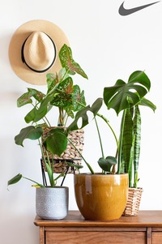
First Image
Decore

Slide 3
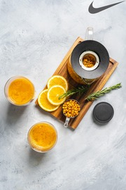
Second Image
Food

Slide 4
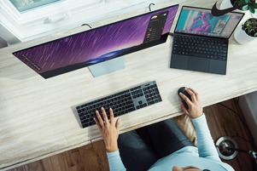
Third Image
Coding

Slide 5
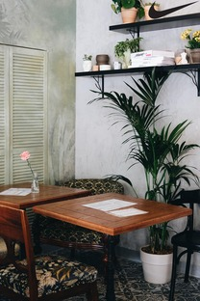
Fourth Image
Interior

Slide 6

Fifth Image
Photograpy

